Slide 1
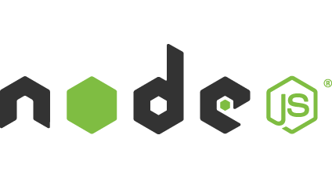
https://www.youtube.com/watch?v=7ypn_WSalj4

Slide 2


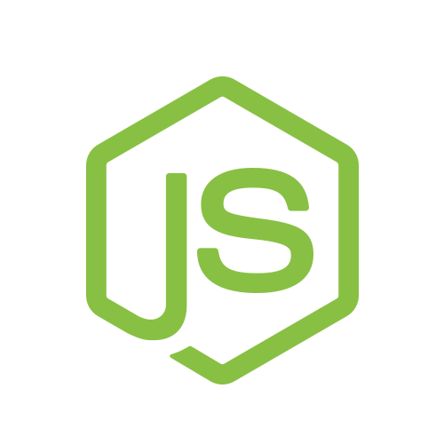
v6 Tech Talks

Slide 3
Agenda
Part 1 - Introduction
Part 2 - Demo

Slide 4
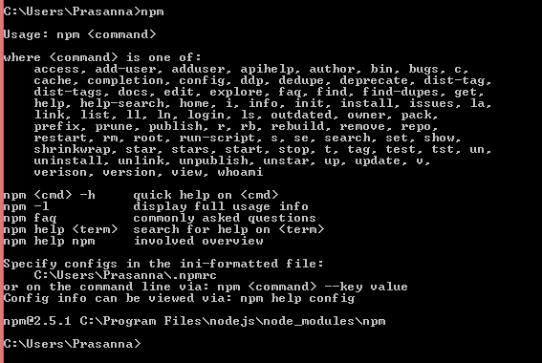
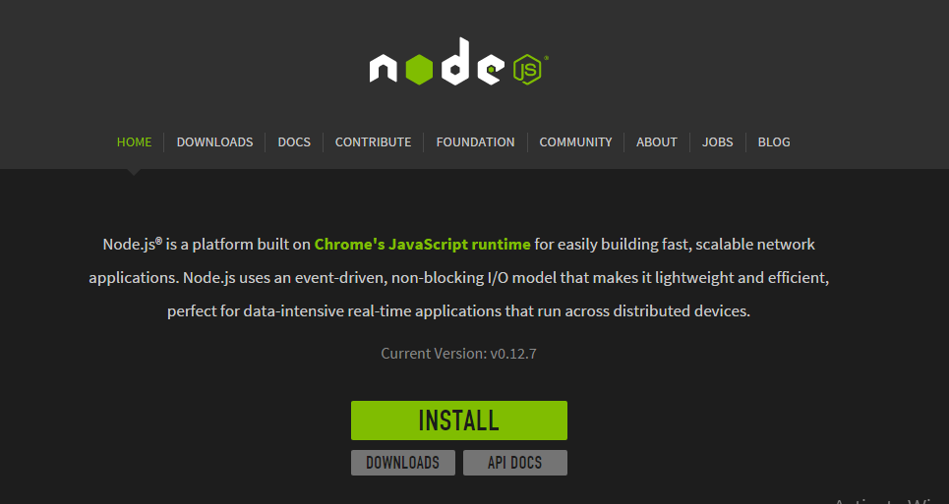
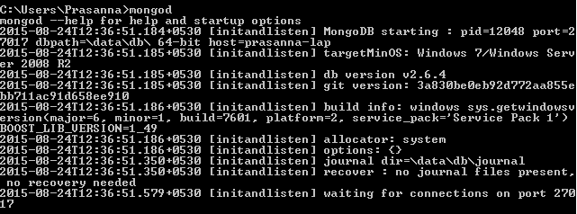

Setting Up Dev Environment
Mandatory
Optional

Slide 5
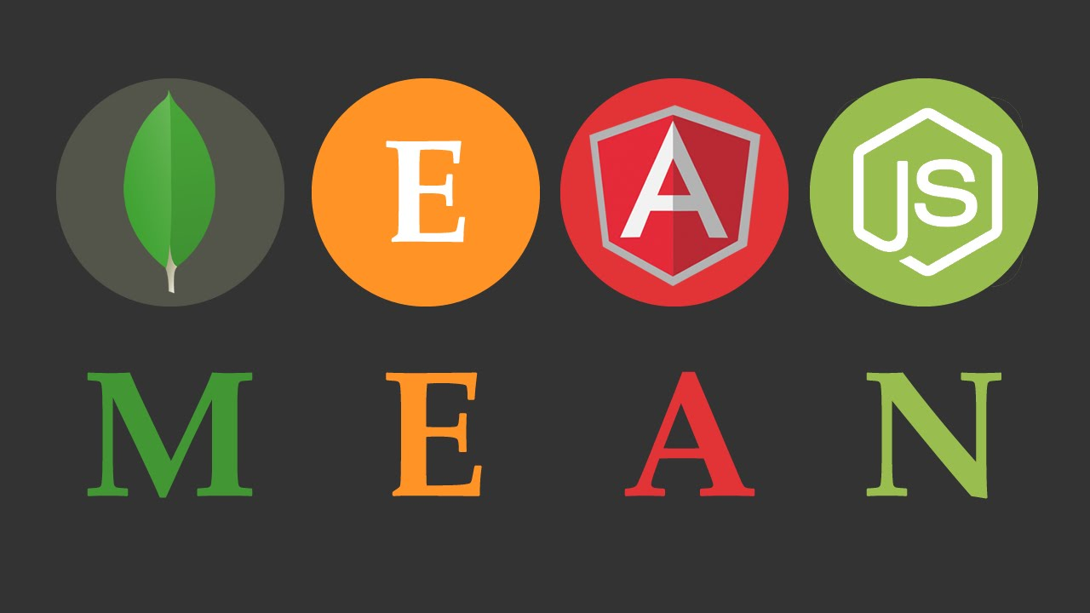
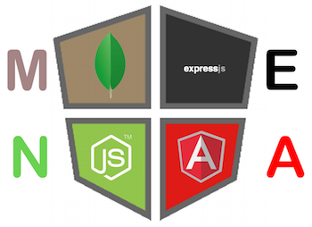

Slide 6
What is Node.js?
Node.js is a platform built on Chrome's JavaScript runtime for easily building fast, scalable network applications.
Node.js uses an event-driven, non-blocking I/O model that makes it lightweight and efficient, perfect for data-intensive real-time applications that run across distributed devices.
Node.js
https://nodejs.org/

Slide 7
Node.js is an open source, cross-platform runtime environment for server-side and networking applications.
Node.js applications are written in JavaScript.
Executed within the Node.js runtime. (Chrome V8 Engine)
Node Package Manager (npm)

Slide 8

History
Invented in 2009 by Ryan Dahl.
Motivated by the file upload progress bar on Flickr. The browser did not know how much of the file had been uploaded and had to query the Web server. Dahl desired an easier way.
In 2011, a package manager was introduced for Node.js library, called npm.

Slide 9
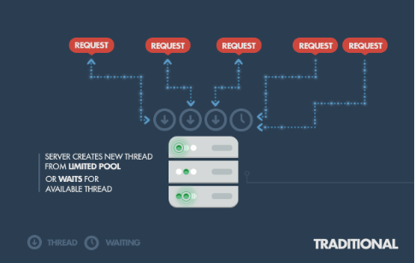

Slide 10
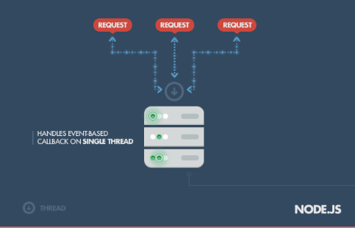

Slide 11





https://github.com/joyent/node/wiki/projects,-applications,-and-companies-using-node
Who are using node?

Slide 12
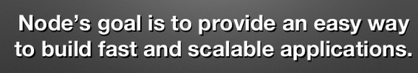
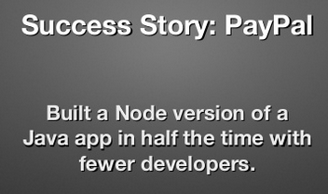
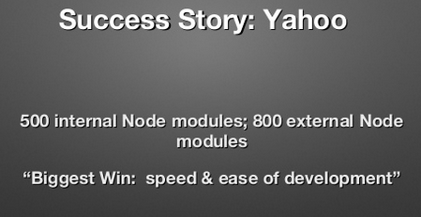
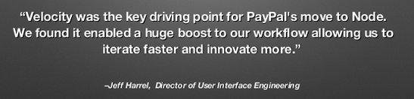
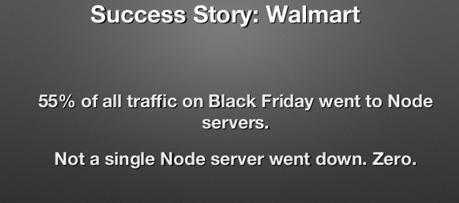
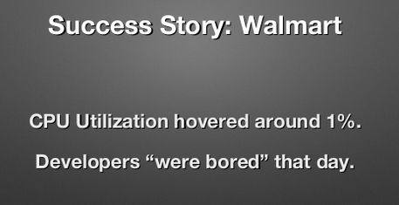
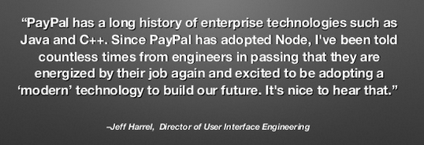

Slide 13
Why Node?
It's Fast
Less Overhead
JJ – “Just JavaScript”
Asynchronous I/O
Package management
Community Driven

Slide 14
Express.js
Express.js is a Node.js web application server framework, designed for building single-page, multi-page, and hybrid web applications. It is the de facto standard server framework for node.js.

Slide 15
Code Reusability
Express.js is to Node.js what Ruby on Rails. Same reason you use jQuery, makes things faster and easier.
Express 3.x is a light-weight web application framework to help organize your web application into an MVC architecture on the server side. You can use a variety of choices for your templating language (like EJS, Jade, and Dust.js).
You can use a database like MongoDB with Mongoose (for modeling) to provide a backend for your Node.js application. Express.js basically helps you manage everything, from routes, to handling requests and views.

Slide 16
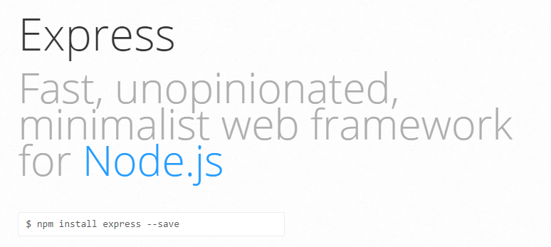

Slide 17


Demo ☺
REST API With Node.js

Slide 18
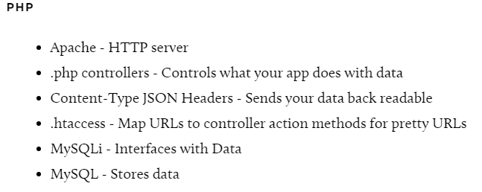
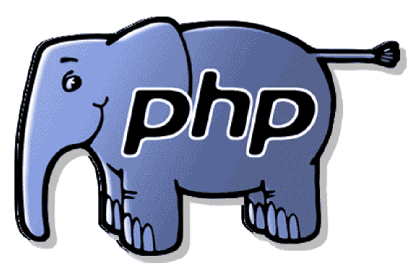
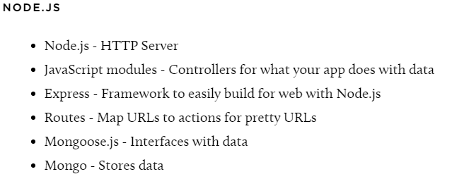
PHP vs Node.js REST Components

Slide 19
Demo ☺

Slide 20


Slide 21
Thank you ☺
.end();

